Slide 1



Reliance Industries Stock Forecast

Slide 2

Mukesh D. Ambani - Chairman and Managing Director - Reliance Industries Limited
Reliance Industries is India’s largest private sector company on all major financial parameters.
In 2004, Reliance Industries (RIL) became the first Indian Private Sector Organisation to be listed in the Fortune Global 500 list.

Slide 3
Mentors And Team Members
Mentors
Neha Ramchandani
Himavanth Ila
Team Members
Akshay Patil
Dhiraj Navale
Disha Sharma
Jayesh Patil
Piyush Dhakate
Pournima Kotgiri

Slide 4
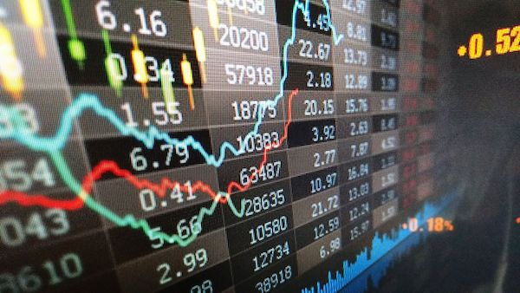
CONTENT
Dataset Details
Exploratory Data Analysis
Visualization
Trends in the data
Model building
Stock price forecasting
Model Evaluation
Deployment

Slide 5
PROJECT ARCHITECTURE
Dataset Details
EDA
Visualization
Model Building
Model Evaluation

Slide 6
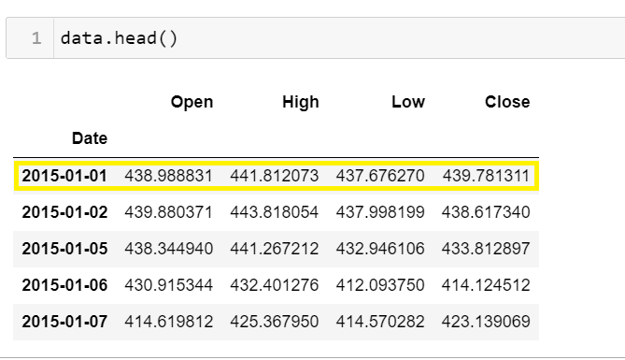
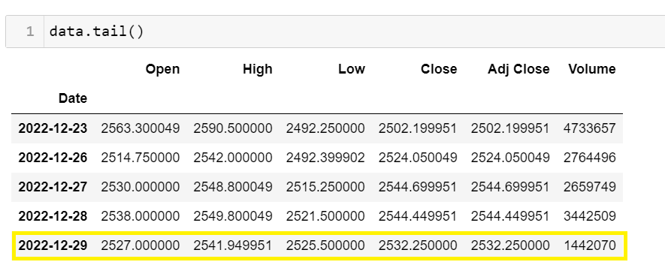
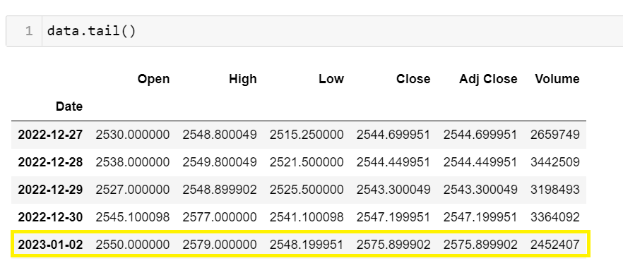
Dataset Details

Slide 7
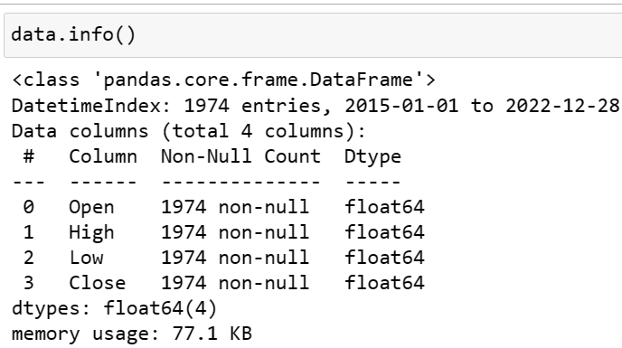
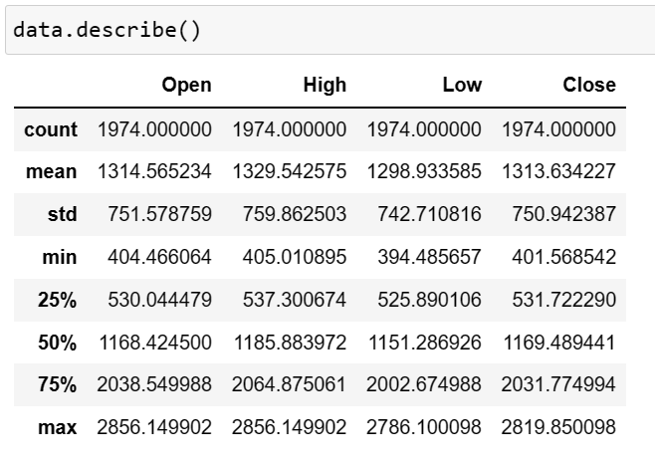
Exploratory Data Analysis
Descriptive Statistics

Slide 8
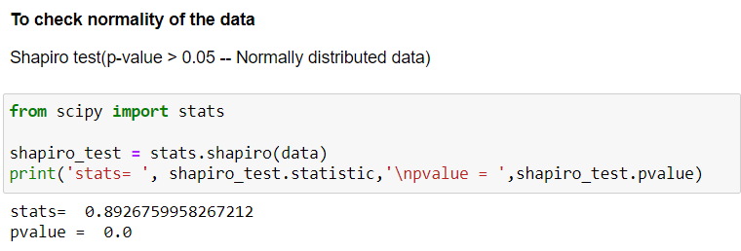
Normality

Slide 9
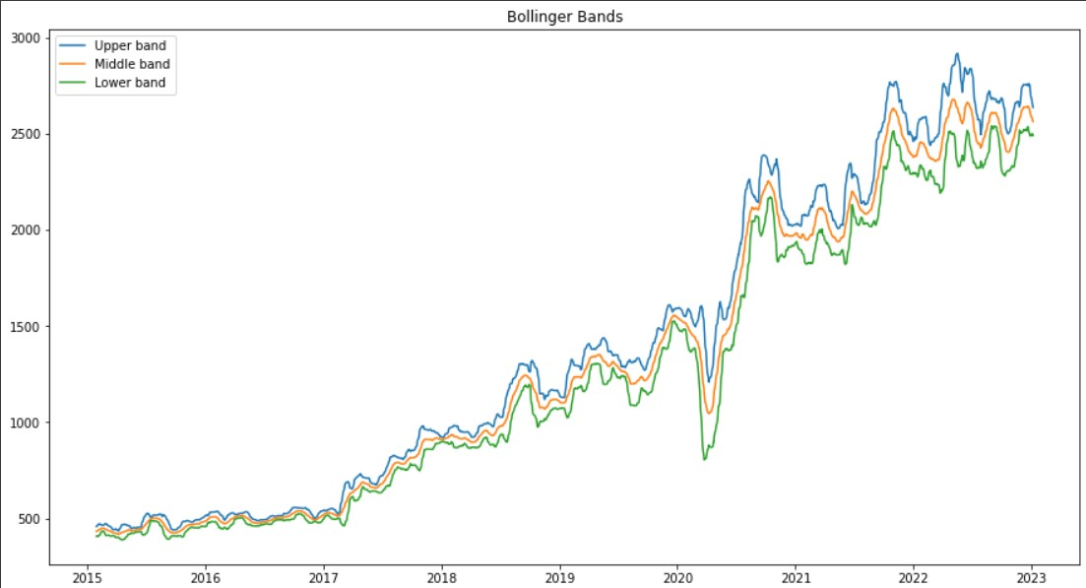
Visualizations
BOLLINGER BANDS INDICATOR
One of the classic trend indicators is the Bollinger bands (BB) indicator,
The indicator is made up of 3 lines – a middle band and two outer ones. The middle band is moving average, usually with the period of 20. Usually the outer bands are set 2 standard deviations above and below the middle band.
When the volatility in the market increases then these bands expand. When the volatility decreases then these bands contract.

Slide 10
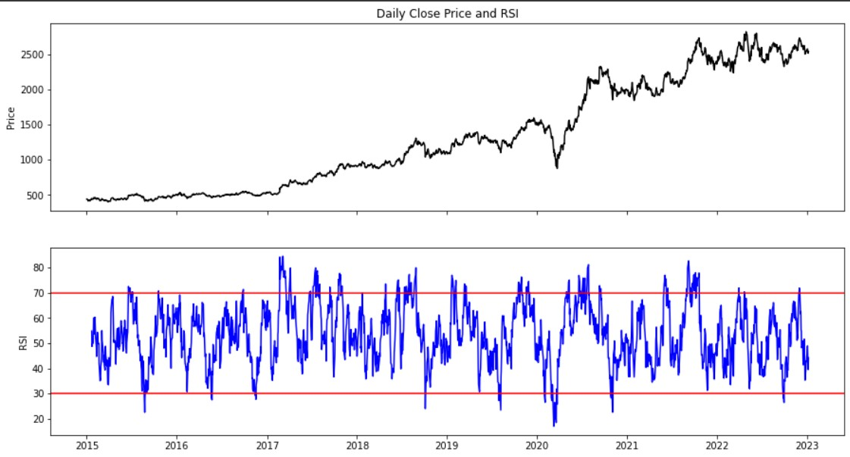
2. Relative Strength Index (RSI)
The Relative Strength Index (RSI), developed by J. Welles Wilder, is a momentum oscillator that measures the speed and change of price movements.
The RSI oscillates between zero and 100.
Traditionally the RSI is considered overbought when above 70 and oversold when below 30.
Signals can be generated by looking for divergences and failure swings.
RSI can also be used to identify the general trend.

Slide 11
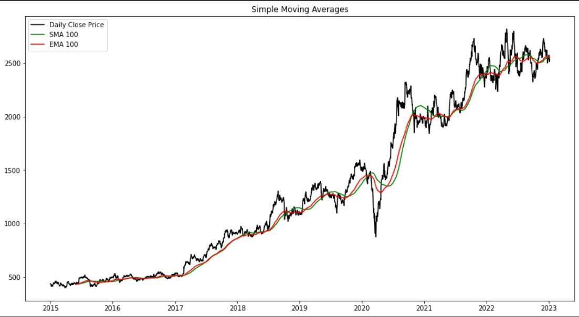
3. Simple Moving Average (SMA)
SMA is the easiest moving average to construct. It is simply the average price over the specified period. The average is called "moving" .
SMAs are often used to determine trend direction.
If the SMA is moving up, the trend is up.
If the SMA is moving down, the trend is down.
A 200-bar SMA is common proxy for the long term trend.
50-bar SMAs are typically used to gauge the intermediate trend.
Shorter period SMAs can be used to determine shorter term trends.

Slide 12
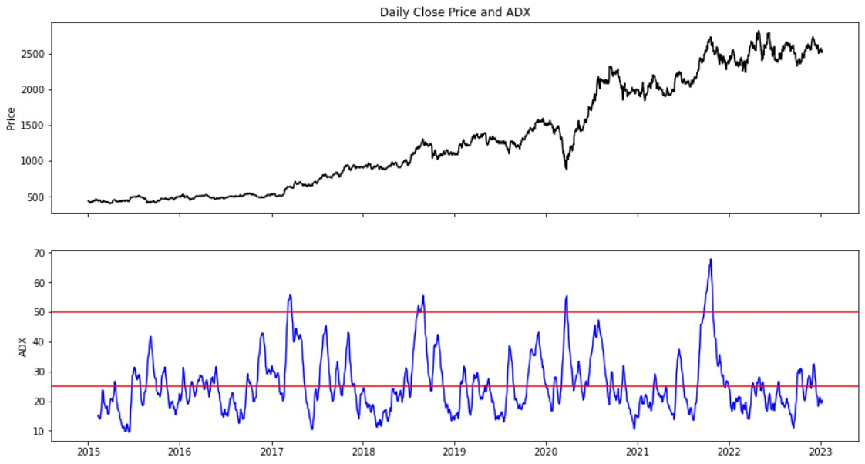
4. Average Directional Movement (ADX)
The average directional index (ADX) is used to determine when the price is trending strongly
ADX is used to quantify trend strength.
ADX calculations are based on a moving average of price range expansion over a given period of time.
The default setting is 14 bars, although other time periods can be used

Slide 13
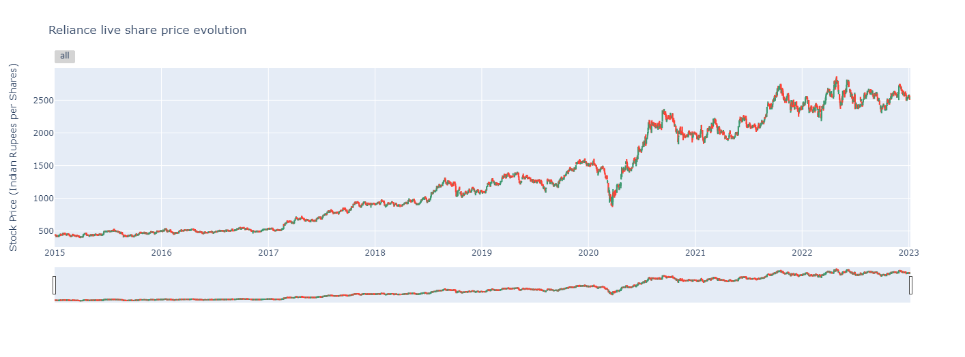
5. Candlestick Pattern
Candlestick charts are used by traders to determine possible price movement based on past patterns.
Candlesticks are useful when trading as they show four price points (open, close, high, and low) throughout the period of time the trader specifies.
Many algorithms are based on the same price information shown in candlestick charts.
Trading is often dictated by emotion, which can be read in candlestick charts.

